Slide 1
Experimental Design
MSDS 660

Slide 2
Experiments*
Experiments: Used to study casual relationships
Manipulate one or more independent variables
Measure their effect on one or more dependent variables
Experimental Design: Creating a set of procedure to systematically test a hypothesis
Requires a strong understanding of the system you are studying
Five Key Steps
Consider your variables and how they are related
Write a specific, testable hypothesis
Design experimental treatments to manipulate your independent variable
Assign subjects to groups, either between-subjects or within-subjects
Plan how you will measure your dependent variable

Slide 3
Experiments
Things also to consider:
Need to select a representative sample
Randomized
Semi-Randomized
Non-Randomized
Control any extraneous variables that might influence your results
Pick the appropriate statistical test

Slide 4
Define your variables
Begin with a research question – anyone have any ideas?
Independent variable:
Dependent variable:
Extraneous variable:
How to control:
Write your hypothesis:
H₀:
H_{a}:

Slide 5
Design experimental treatment
The manipulation of independent variables affect the experiment’s external validity
The extent to which the results can be generalized and applied to the population
Treatment options
Different levels (ranges) of manipulation
Categorical variables – binary, factor levels
Continuous variable

Slide 6
Assign your subjects
Application of experimental treatments to test subject affect the validity and reliability of the results
Validity: how accurately a method measures what it is intended to measure
Reliability: how consistently a method measures something
Study size: the more subjects the greater the experiment’s statistical power (how much confidence you can have in your results)
Control group: receives no treatment (tells us what would happen without experimental intervention)

Slide 7
Randomization
Completely randomized design: Every subject is assigned to a treatment group at random
Randomized block design (stratified): Subjects are first groups according to a characteristic they share, then randomly assigned to treatments within those groups
Quasi-experimental design: The researcher does not have control over the treatment, but instead uses pre-existing groups that received different treatment after the fact
Nonequivalent groups: researcher chooses existing groups that appear similar, but where only one of the groups experiences the treatment
Regression discontinuity: Treatments that are designed around an arbitrary threshold
Natural: An external event or situation result in the random or random-like assignment of subject to assign subject to treatment groups
Notes:
Example: Quasi-experimental design:
You discover that a few of the psychotherapists in the clinic have decided to try out the new therapy, while others who treat similar patients have chosen to stick with the normal protocol.
You can use these pre-existing groups to study the symptom progression of the patients treated with the new therapy versus those receiving the standard course of treatment.
Although the groups were not randomly assigned, if you properly account for any systematic differences between them, you can be reasonably confident any differences must arise from the treatment and not other confounding variables.
Example: Nonequivalent groups design
You hypothesize that a new after-school program will lead to higher grades. You choose two similar groups of children who attend different schools, one of which implements the new program while the other does not.
By comparing the children who attend the program with those who do not, you can find out whether it has an impact on grades.
Example: Regression discontinuity
Some high schools in the United States are set aside for high-achieving students, who must exceed a certain score on a test to be allowed to attend. Those who pass this test most likely differ systematically from those who do not.
However, since the exact cutoff score is arbitrary, the students near the threshold—those who just barely pass the exam and those who fail by a very small margin—tend to be very similar, with the small differences in their scores mostly due to random chance. You can therefore conclude that any outcome differences must come from the school they attended.
To test the impact of attending a selective school, you can study the long-term outcomes of these two groups of students (those who barely passed and those who barely failed).
Example: Natural experiment
The Oregon Health Study is one of the most famous natural experiments. In 2008, the state of Oregon decided to expand enrollment in Medicaid, America’s low-income public health insurance program, to more low-income adults.
However, as they could not afford to cover everyone who they deemed eligible for the program, they instead allocated spots in the program based on a random lottery.
Researchers were able to study the impact of the program by using the enrolled individuals as a randomly assigned treatment group, and the others who were eligible but did not succeed in the lottery as a control group.

Slide 8
Between/Within subjects
Between subject design: individuals only receive one of the possible levels of an experimental treatment
Matched pairs: ensures that each treatment group contains the same variety of test subjects in the same proportions
Within subject design: every individual receives each of the experimental treatments consecutively
Counterbalancing: randomizing or reversing the order of treatments among subjects is used to ensure that the order of treatment application doesn’t influence the result of the experiment

Slide 9
Measuring your dependent variable
Decide how you’ll collect data on your dependent variable outcomes
Aim for reliable and valid measurements
Minimize bias or error
Operationalized: turning abstract concepts into measurable observations
Collection and measurements of data will affect what type of statistical analysis you can use
Experiments are always context-dependent
Take in consideration all of the unique aspects of your system to produce information that is valid and relevant to your research question
Notes:
Operationalization example
The concept of social anxiety can’t be directly measured, but it can be operationalized in many different ways. For example:
self-rating scores on a social anxiety scale
number of recent behavioral incidents of avoidance of crowded places
intensity of physical anxiety symptoms in social situations

Slide 10
Other considerations
Blind experiment: some of the people involved are prevented from knowing certain information that might lead to a conscious or subconscious bias on their part
Causes invalid results
Great with placebo effect measurements
Double blind experiment: Both the subject and the person administering the treatment do not know whether the subject is in the experimental or control group
Minimize the effect of confounding variables
Inter-rater reliability: The degree of agreement among independent observers who rate, code, or asses the same phenomenon

Slide 11
General Thoughts
Inferences need to be justified based on how the data were collected, how the study was designed, what exactly was measured, how possible confounding or biasing effects were address, and how sources of error are accounted for
Plotting is underrated – we learn more form a picture than a statistical output
accidental aRt (@accidental__aRt) / Twitter
Whenever possible, report interpretable statistics and explain what their value means with respect to the study

Slide 12
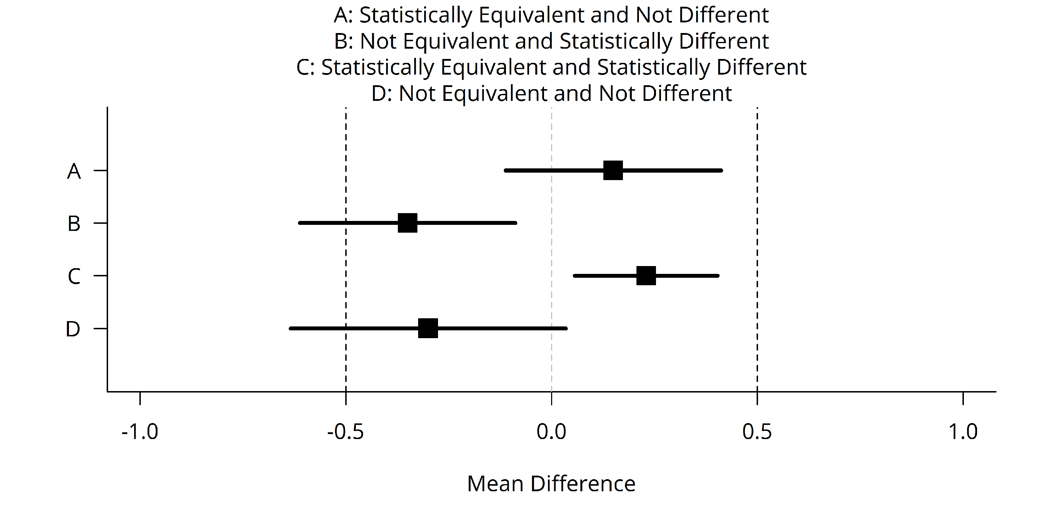
General Thoughts
“The difference between significant and not significant is not itself significant”
Things that were significant may become not significant anymore
Should we care?
Does it provoke action?
What does it mean in the context?

Slide 13
General thoughts
Testing nulls: Do you think the null could be true?
If you don’t think it can be true, why do you care that you’ve rejected it?
What purpose is served by controlling the error rate of something that never happens in the first place?
What kind of error do we care about? Rejecting if the null is true, or the null being true if we reject?
P-values: When you think the null could be true
Signal detection and quality control
Election fraud
Trick decks
Declaring “significance”: is there a real decision to be made? Is it necessary for the decision to be binary?

Slide 14
Links
Spurious Correlations (tylervigen.com)
Calling Bullshit.
Tools - Misleading axes on graphs (callingbullshit.org)
Tools - Proportional Ink (callingbullshit.org)
UN Says Climate Genocide Coming. But It’s Worse Than That. (nymag.com)
2018 FL-DSSG Girls Inc. JAX – YouTube

Slide 15
Homework
Do a write up (report) regarding the statistical methods deployed in the article - comment and back up your opinion regarding the collection, methods, design, and conclusion. Compare these between the articles. Questions to keep in mind are:
Am I left with any questions?
Is this credible?
So what? What’s actionability?
Does it make sense with the context? When? Who? Where?
Is it relevant?
Is there a bias?
Does the statistical experiment make sense?

